Slide 1

Select Topics In Python
Logical Operators
Adwith Malpe

Slide 2
Objectives
Objectives
What are Logical Operators?
Demo

Slide 3
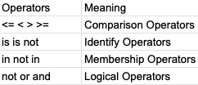
What are Logical Operators?
What are Logical Operators?
Operators used to perform logical operations on the value of variables
Returns a true or false value
Logical Operators are used heavily in If Statements
3 main types of logical operators in Python: logical AND, logical OR, and logical NOT

